Slide 1

Hangman

Slide 2
Installations
Git
VS Code
Python

Slide 3
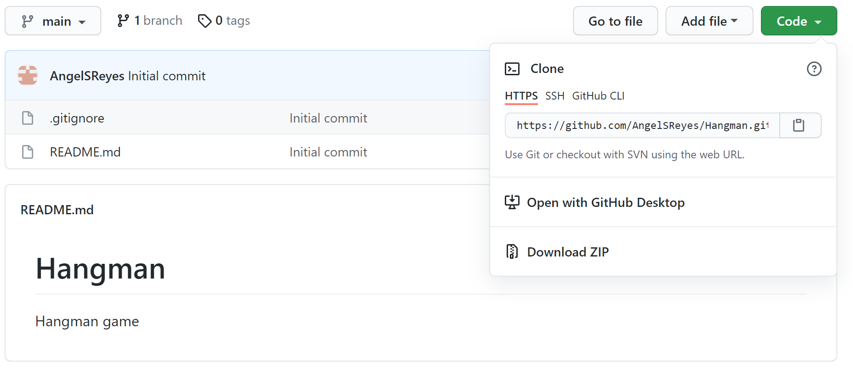
Git
Clone repository
“git clone <>”

Slide 4
Git
Create and use a new branch
“git branch <>” Create the branch
Eg: git branch initial_skeleton
“git checkout <>” Use this branch

Slide 5
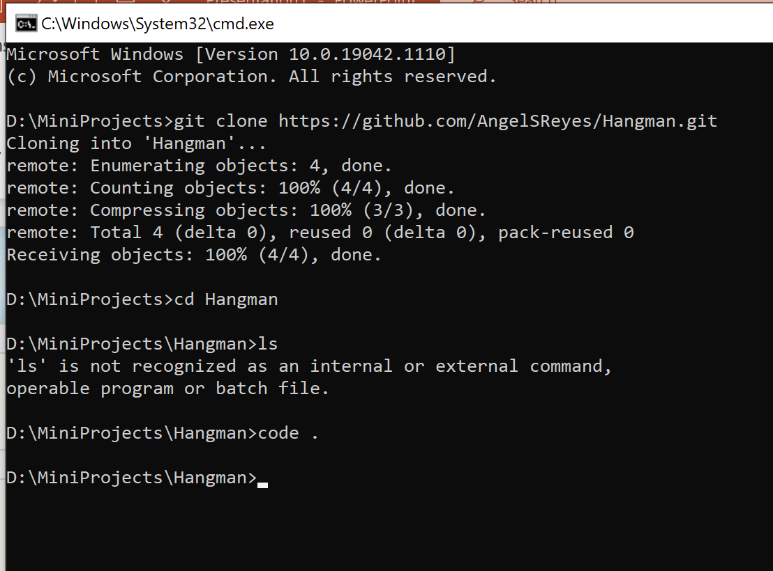
VS Code
“code .”
This will open VSCode

Slide 6
Functions and Variables Naming Convention
First letter should be lowercase with new letters being uppercase
Eg: checkIfPrimeNumber

Slide 7
Requirements
Welcome to the game announcement.
Program randomly selects a secret keyword from a list of secret keyword.
When a letter in that word is guessed correctly, that letter position in the word is made visible.
Length of given word + 2 chances. For example, word to be guessed is mango, then user gets 5 + 2 = 7 chances, as mango is a five letter word.
Skelatol

